Slide 1

JAVA SCRIPTING
SSP
Notes:
ssp

Slide 2
What is JavaScript?
JavaScript was designed to add interactivity to HTML pages
JavaScript is a scripting language (a scripting language is a lightweight programming language)
A JavaScript consists of lines of executable computer code
A JavaScript is usually embedded directly into HTML pages
JavaScript is an interpreted language (means that scripts execute without preliminary compilation)
Everyone can use JavaScript without purchasing a license

Slide 3
What can a JavaScript Do?
JavaScript is used in web pages for:
  Dynamics : mouse clicks, pop up windows, and animations
  Client-side execution : validating input, processing requests
It avoids Client/Server communication and traffic
JavaScript is executed on client-side
JavaScript is simple, powerful, and interpretive language and requires only a web browser
There have been a number of revisions
Two types of JavaScript exists:
  Client-side → code is sent to the client’s browser for execution
  Server-side → code stays on the server for execution

Slide 4
What can a JavaScript Do? …
JavaScript gives HTML designers a programming tool - HTML authors are normally not programmers, but JavaScript is a scripting language with a very simple syntax!
JavaScript can put dynamic text into an HTML page - A JavaScript statement like this: document.write("<h1>" + name + "</h1>") can write a variable text into an HTML page
JavaScript can react to events - A JavaScript can be set to execute when something happens, like when a page has finished loading or when a user clicks on an HTML element

Slide 5
What can a JavaScript Do?...
JavaScript can read and write HTML elements - A JavaScript can read and change the content of an HTML element
JavaScript can be used to validate data - A JavaScript can be used to validate form data before it is submitted to a server.
JavaScript can be used to detect the visitor's browser - A JavaScript can be used to detect the visitor's browser, and - depending on the browser - load another page specifically designed for that browser
JavaScript can be used to create cookies - A JavaScript can be used to store and retrieve information on the visitor's computer

Slide 6
What can a JavaScript Do?...
Client side validation -
  This is really important to verify any user input before submitting it to the server and Javascript plays an important role in validting those inputs at front-end itself.
Manipulating HTML Pages -
  Javascript helps in manipulating HTML page on the fly. This helps in adding and deleting any HTML tag very easily using javascript and modify your HTML to change its look and feel based on different devices and requirements.
User Notifications -
  You can use Javascript to raise dynamic pop-ups on the webpages to give different types of notifications to your website visitors.
Back-end Data Loading -
  Javascript provides Ajax library which helps in loading back-end data while you are doing some other processing. This really gives an amazing experience to your website visitors.
Presentations -
  JavaScript also provides the facility of creating presentations which gives website look and feel. JavaScript provides RevealJS and BespokeJS libraries to build a web-based slide presentations.
Server Applications -
  Node JS is built on Chrome's Javascript runtime for building fast and scalable network applications. This is an event based library which helps in developing very sophisticated server applications including Web Servers.

Slide 7
Javascript frameworks
There are many useful Javascript frameworks and libraries available:
Angular
React
jQuery
Vue.js
Ext.js
Ember.js
Meteor
Mithril
Node.js
Polymer
Aurelia
Backbone.js etc.

Slide 8
A Comparison of Java and JavaScript
 | JavaScript | Java
Program Compilation | Not Necessary | Necessary
Class, Inheritance | Object-based/Object-Oriented. (https://developer.mozilla.org/en-US/docs/Learn/JavaScript/Objects/Object-oriented_JS) | Object-Oriented. Applets consist of object classes with inheritance. (Class-based object model )
Coding | Code integrated with ,and embedded in HTML | Applets distinct from HTML. accessed from HTML pages
Variable Declaration | Variable data types not declared. | Variable data types must be declared.
Script Execution | Interpreted and executed by client | Bytecodes (compiled files) downloaded from server, executed on client
HTML Document Manipulation | Possible | Not Possible

Slide 9
Objects Overview
JavaScript is an Object Oriented Programming (OOP) language. A programming language can be called object-oriented if it provides four basic capabilities to developers −
Encapsulation − the capability to store related information, whether data or methods, together in an object.
Aggregation − the capability to store one object inside another object.
Inheritance − the capability of a class to rely upon another class (or number of classes) for some of its properties and methods.
Polymorphism − the capability to write one function or method that works in a variety of different ways.

Slide 10
JavaScript coding and Execution
What you need for Java Script
    A text editor
    A JavaScript Compatible web browser
JavaScript | Nestcape Navigator | Internet Explorer
1.3 | 4.06 | 5.0 and above

Slide 11
Learning JavaScript
Special syntax to learn
Learn the basics and then use other people's (lots of free sites)
Write it in a text editor, view results in browser
You need to revise your HTML
Notes:
To learn JavaScript you will need to learn some of its language syntax.
However, a good strategy is to learn the basics, and then use and adapt other people's JavaScript. There are plenty of sites on the internet offering free JavaScript (see slide 4) with the calculator example. Other useful addresses are provided in the notes of last slide.
As with HTML, JavaScript can be written in a text editor and viewed in a browser. As it is a programming language the syntax is quite strict (compared to HTML). It is also a good idea to make sure your HTML is up to scratch as this will save you time. The hands-on exercises contain an refresher exercise on HTML forms.

Slide 12
Tips
Check your statements are on one line
Check your " and ' quotes match
Take care with capitalisation
Lay it out neatly - use tabs
Notes:
Some tips for debugging and clarity to make it easier for you (the trainer) as well as for the audience. Follow the conventions we have used for capitalisation which will make it easier to read / find mistakes.
References:An alternative site with ready made scripts for download:
http://builder.com.com/
Follow links to Web Development and then JavaScript to see a number of good examples.

Slide 13
How to Embed JavaScript
<html> <body>
<script type="text/javascript"> ... </script> </body> </html>
FROM HTML 4.01
<html>
<body>
<script type="text/javascript"> document.write("Hello World!") </script>
</body>
</html>
<SCRIPT LANGUAGE=“JavaScript”>
JavaScript statements here
</SCRIPT>
Earlier

Slide 14
Embedding JavaScript in XHTML
<script> tag is used to embed JavaScript code in XHTML code of a web page
The <script> tag can be used anywhere inside the code but it is usually embedded right before of after the <head> tag closes
Any number of <script> tags can be embedded, but usually one tag is enough
Nesting <script> tags is prohibited and generates errors
HTML editors do not follow the <script> tag guidelines and embed the tag any where and any number of times

Slide 15
Development Environment
JavaScript source code is written in an editor and run and tested in a browser, like XHTML
Error in JavaScript code prevent the page from being rendered and thus debuggers are needed to find where the errors are
JavaScript interpreters serve the purpose by showing where the error is
Errors are reported one at a time and are usually easy to fix

Slide 16
JavaScript Statements
<html>
<head><title>My Page</title></head>
<body>
<script language="JavaScript">
document.write('This is my first →
JavaScript Page');
</script>
</body>
</html>
Note the symbol for
line continuation
Notes:
JavaScript can be contained either in the header section of an HTML page or in the body. This JavaScript statement is shown as a pure JavaScript statement within SCRIPT tags.
Notice that there is no HTML in the body of this page at all. (Demonstrate what this JavaScript looks like in a web browser).
This statement writes a line of text on a web page.
The command document.write is a standard function in JavaScript to write text to the page. The following is a more technical explanation for background information only:
document.write is derived from the JavaScript object model (not covered in detail here). It works on the principle that all document and browser elements have an object name (document, window, image etc) and can each has various properties that can be manipulated. The object hierarchy means that individual elements can be uniquely identified i.e. document.myform.mytext would refer to the text entry named mytext within the form called myform within the current page (document).
The arrow symbol '→' is used in these slides and in the workbook to indicate where a JavaScript statement should be typed on one line without a break. A line break in the wrong place will stop JavaScript from working.e.g.
document.write('This is my first →
JavaScript Page');
should actually be typed:
document.write('This is my first JavaScript Page');

Slide 17
JavaScript Statements
<html>
<head><title>My Page</title></head>
<body>
<script language=“JavaScript">
document.write('<h1>This is my first →
JavaScript Page</h1>');
</script>
</body>
</html>
HTML written
inside JavaScript
Notes:
This example demonstrates that anything included within the quotes in the document.write statement is printed to the screen, and this includes HTML tags. The <h1> tag is delivered to the browser along with the text, and the browser would interpret it as a normal HTML file, displaying the text in the Heading 1 style.
IMPORTANT NOTE:
This example shows a JavaScript statement in the <body> of the web page.
It is possible to include JavaScript statements in the <head> section of a web page but care must be taken that they do not try to access items that don't exist until the page has loaded (e.g. form elements, links, images). The web browser parses (reads through and executes) any script commands as it displays the page.
In most cases it is common sense that dictates where a statement should be placed.
If, in the above example, document.write was placed in the <head> of the page, the text "This is my first JavaScript Page" would appear in the <head> of the finished page – this would be incorrect – although modern browsers will let you get away with it!
In some circumstances you may wish to use document.write in the <head> - for example to dynamically generate <meta> or <title> tags. Such uses are not considered here.
JavaScript functions are typically defined in the <head> section of a web page as they do not normally execute until they have been triggered elsewhere. The use of functions in JavaScript is covered in the Netskills Training Module: "Further JavaScript (Enhancing JavaScript with Functions and Events)"

Slide 18
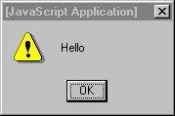
JavaScript Statements
<html>
<head><title>My Page</title></head>
<body>
<p>
<a href="myfile.html">My Page</a>
<br />
<a href="myfile.html"
onMouseover="window.alert('Hello');">
My Page</A>
</p>
</body>
</html>
JavaScript written
inside HTML
An Event
Notes:
Compare this example with the previous one. This time the JavaScript is written inside the HTML tags and there are no <script> tags.
In this case if the browser is JavaScript-enabled it will process the commands when it needs to. If the browser doesn't understand JavaScript it will ignore the extra code (it should see it as an HTML attribute that it cannot process and therefore ignores, although very old browsers my throw an error)
This example demonstrates an HTML hyperlink, but notice the JavaScript enclosed within the <a href.. tag of the second link.
onMouseOver is referring to an event. That is, this JavaScript will happen in response to something that the user does e.g click a button, or in this case, when they move the mouse over the link (this will not happen if you move your mouse over the first link!).
window.alert will display what is called an alert box on the screen containing the text specified, in this case, "hello".
The first link will behave normally.

Slide 19
How to Notate Comments
Use a double slash (//)
    Web browsers interprets a single line proceeded by // As a comment
Enclose comments between /* and */
    Web browsers interprets an area enclosed by /* and */ as comments.
    This notation is used when you have comments that span multiple lines
<SCRIPT LANGUAGE =“JavaScript”>
// Your comment here
</SCRIPT>
<SCRIPT LANGUAGE =“JavaScript”>
/* more comment here
more comment here */
</SCRIPT>

Slide 20

Displaying a Document
Use document.write() for Displaying text and graphics in the browser window
    If you specify a string in document.write(), then browser will display the specified string.
document.write(“string here”);
You can specify HTML tags within documents.write()
document.write("<IMG SRC='Image/neko.gif' ALIGN='left'>
JavaScript for displaying image here.
<br>string here”);
When displaying multiple data, separate items by a comma(,) or a plus (+) sign
Num=20;
Document.write(“The price is”,Num, “.Thank you.”);

Slide 21
Variables …
A variable is a symbolic name that stores a value and has the some characteristics
Identifiers
The name of the variable is its identifier
It must begin with a letter, underscore, or $ sign
It cannot begin with a number or other characters
JavaScript is case-sensitive
Examples: test, Test, jam234, _best, $abc, a_1$4
Types
Data types are implicit and are converted automatically
The first use of a variable declares its types
Types can be numbers (integer or real), logical (boolean), or string
Examples: 3, 40, -10.5, true, false, “zeid”, “9abc”

Slide 22
Variables
Before you use a variable in a JavaScript program, you must declare it. Variables are declared with the var keyword as follows.
<script type = "text/javascript">
<!--
var money;
var name;
//-->
</script>
You can also declare multiple variables with the same var keyword as follows −
<script type = "text/javascript">
<!--
var money, name;
//-->
</script>
Notes:
ssp

Slide 23
Variables…
Storing a value in a variable is called variable initialization. You can do variable initialization at the time of variable creation or at a later point in time when you need that variable.
For instance, you might create a variable named money and assign the value 2000.50 to it later. For another variable, you can assign a value at the time of initialization as follows.
<script type = "text/javascript">
<!--
var name = "Ali";
var money;
money = 2000.50;
//-->
</script>
JavaScript is untyped language. This means that a JavaScript variable can hold a value of any data type. Unlike many other languages, you don't have to tell JavaScript during variable declaration what type of value the variable will hold. The value type of a variable can change during the execution of a program and JavaScript takes care of it automatically.

Slide 24
Variables…
JavaScript variables have only two scopes.
Global Variables − A global variable has global scope which means it can be defined anywhere in your JavaScript code.
Local Variables − A local variable will be visible only within a function where it is defined. Function parameters are always local to that function.
<html>
<body onload = checkscope();>
<script type = "text/javascript">
<!--
var myVar = "global"; // Declare a global variable
function checkscope( ) {
var myVar = "local"; // Declare a local variable
document.write(myVar);
}
//-->
</script>
</body>
</html>

Slide 25
Variables
A variable can hold data such as numbers or characters
    A variable name must with a letter,
    an underscore(“_”)
    or a dollar($)
<body>
<script language="javascript">
<!--
a=100;
document.write(a);
abc=20-10;
document.write(abc);
_abc=30-5;
document.write(_abc);
$abc=40-2;
document.write($abc);
answer=100-10*2;
document.write(answer);
//-->
</script>
</body>

Slide 26
Variables
Scope
The code block within which the variable is available
Global variable is available everywhere
Local variable is available only inside a code block
Global variables are easy to manage but a bad habit
Constants
Read only variables defined by a const keyword
Cannot change values or be re declared
Examples: const x=22
Literals
Fixed values (hard-coded values) in JavaScript
Nesting literals needs extra care
Examples: 3.5, false, “Hello”
Data Type Conversion
JavaScript converts data types automatically, but creates confusion
Examples: answer=true, answer=20
Escaping and Special Characters
Backslash is the escaping character and is used to define special ones

Slide 27
Statements
A statement uses an assignment operator, an equal sign
The operator has two operands on each of its side and the value of the right operand is assigned to the left one
Example : x = y
Values of right operand must always be known, if not, and error is generated
Statement must be only one line long and cannot be broken
Semicolon (;) is used to separate statements
JavaScript also provides comment statements

Slide 28
Expressions and Operators
Expressions are a valid set of any variables that evaluates to a single value
  Arithmetic Expressions evaluate to numbers
  Logical Expressions evaluate to booleans (true or false)
  String Expressions evaluate to strings
JavaScript has a rich set of operators
  Assignment Operators → =, +=, -=, *=, /=
  Comparison Operators → ==, !=, >, >=, <, <=
  Arithmetic Operators → +, -, *, /, %, ++, --
  Logical Operators → &&, ||, !

Slide 29
Control Structures
Control structures control the code execution according to a certain criteria
Conditional Statements
- Executes if the specified condition statement is met
- if and switch statements are the two types
if statements: structure 1: if (condition) {…………}
structure 2: if (condition) {…………}
else {…………}
switch statement: switch (expression){
case condition1:
statements; break;
case condition2:
statements; break;
default:
statements;}

Slide 30
Control Structures
Loop Statements
- Executes repeatedly till a specific condition is met
- for, while, and do while statements are used
- break exits the loop all together
- continue skips the current iteration
for statement: for (ini value; end value; incr){
statements
}
while statement: while (condition) {
statements
}
do while statement: do {
statements
}while (condition)

Slide 31
Code Execution
JavaScript code shell looks like:
<script language=“javascript”>
function definition code
function definition code
function definition code
statements
function calls
statements
function calls
</script>
JavaScript interpreter executes code top to bottom, left to right
Function definitions are executed only when called

Slide 32
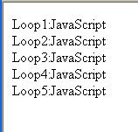
Loop - for
Use a for loop statement when you want to repeat statements a fixed no. of. Times.
For (initial expression; terminating condition; increment expression){
process;
.
.
}
for (i=1; i<6; i++){
document.write("Loop",i,":JavaScript<br>");
}
Initial Value
Condition
FALSE
TRUE
Process
Increment

Slide 33
Conditional Branching
Use the if statement to perform separate statements according to a condition
if
Condition
FALSE
if (condition){
statement for when condition1 is true;
} else {
statement for when condition1 false
}
TRUE
Process1
Process2
Else if
if (condition1){
statement for when condition1 is true;
} else if (condition2){
statement for when condition2 true;
} else {
statements for when all condition are false;
}
Condition1
FALSE
TRUE
FALSE
Process1
Condition2
TRUE
Process2
Process3

Slide 34
Functions
A function groups together a set of statements under a named subroutine. A function can be called by that name whenever its action is required.
Reasons for use;
    Reuse script
      You can simply call the function as necessary and avoid rewriting the entire block of code again.
    Clarify your program
      Functions make the purpose of each section clear and thus makes your script coding more efficient.
    Easy maintenance
      You can simply change that part
What is an argument
    Arguments are variables used in the functions. The values in the variable are passed on by the function call
What is a return value?
    A return value is value returned to the calling expression. It can be omitted if a return value is not necessary.

Slide 35
Defining Functions
How to define and call functions;
<HTML>
<HEAD>
<SCRIPT LANGUAGE=“JavaScript”>
Function function_name (argument, argument,…) {
my_statemetn;
:
return return_value;
}
</SCRIPT>
</HEAD>
<BODY>
<SCRIPT LANGUAGE=“JavaScript”>
variable_name = function_name (argument, argument,…);
</SCRIPT>
</BODY>
</HTML>
1
3
Function Definition
The returned value from the function is assigned to this variable
2
Calling a function

Slide 36

Function Example
The function is defined in the <HEAD> section, and called from the <BODY> part of the HTML document.
<html><head>
<title>kansu.html </title>
<script language="javascript">
function kansu (i){
result= i*1.05;
return result;
}
</script>
</head>
<body>
The result of the multipication of 100 and 1.05 is:
<script language="javascript">
<!--
x=kansu(100);
document.write(x);
//-->
</script>
</body></html>

Slide 37
Event Procedures / handlers
What are events
    Events are actions that occur usually as a result of something a user does such as clicking a mouse.
Event Handlers
    Events handlers identify such events and they can be placed within the HTML tags.
Event Handler | Occurs when…
onChange | User changes value of text, textarea or select element
onClick | User clicks on form element or link
onFocus | User gives form element focus
onLoad | User loads the page
onUnLoad | User unloads the page (exit)
onMouseOut | User moves mouse pointer off of link or anchor
onMouseOver | User moves mouse pointer over a link or anchor
onSelect | User selects form element’s input field
onSubmit | User submits a form
onReset | User resets form fields

Slide 38
Event Procedure Example
<INPUT TYPE=“button” onClick=“some JavaScript code here or some function name here”>
<INPUT TYPE=“button” VALUE=“display message”
onClick=“alert(‘Welcome to my homepage’)”>
<html>
<head>
<title>event.html </title>
<script language="javascript">
function message(){
alert("Welcome to my home page");
}
</script>
</head>
<body>
<a href="http://www.flm.fujitsu.com/" onMouseOut="message()">
Welcome to the home page
</a>
</body>
</html>

Slide 39
Using Objects
What is an Object ?
    An object consists of a collection of data and processes (methods)
What is a Property?
    A property is equivalent of object data or a value.
    Javascript defines properties as variables
What is a Method
    A method defines what takes to perform.
    In Javascript a method is a function call.
Types of Predefined objects
    String Objects (For working with text)
    Date Object (for working with dates and times)
    Math Objects (Mathematical constants and functions)
    Array object (To store a set of values in a single variable)
    Number Object (working with numbers)
    RegExp (Provides simple regular expression pattern searches.

Slide 40

Example Script for Getting Dates and Time
<html>
<head>
<title>Date and Time </title>
</head>
<body>
The program will display the current year, month, date hour, minute, and second.<br>
<script language="javascript">
<!--
// Creating an Date object
now = new Date();
/* Getting and Displaying the year, month, date, hour, minute, and second*/
document.write(now.getFullYear()+"Year");
document.write(now.getMonth()+1,"Month",now.getDate(),"date");
document.write(now.getHours(),"hour",now.getMinutes(),"minute");
document.write(now.getSeconds(),"second");
//-->
</script>
</body>
</html>

Slide 41
Example Script for Closing a Window
<HTML>
<HEAD>
<TITLE>new.html</TITLE>
</HEAD>
<BODY bgcolor="ffcc99" onload="setTimeout('window.close()',10000)">
I am a cat!!<BR><BR>
<IMG SRC = 'image/neko.gif'><BR><BR>
<script language="javascript">
<!--
document.write("The last modified date/time:", document.lastModified,"<br>");
//--> </script>
<form>
<input type="button" value="close" onClick="window.close()">
</form>
</BODY>
</HTML>

Slide 42

Example Script for Last Modified Date and Time
<html>
<head>
<title>The last modified date and time</title>
</head>
<body>
<script language="javascript">
<!--
document.write("The last modified date/time:", document.lastModified);
//-->
</script>
</body>
</html>

Slide 43
Input and Output
Client-side JavaScript has limited input/output utilities due to security reasons
The input functions available are:
prompt (message, default) → takes an input and returns it to the JavaScript program
confirm (question) → asks the user to confirm an input value and return a boolean value
The output functions available are:
document.write (string)
alert (string)
Both these functions are used to output results in a web page

Slide 44
HTML Forms and JavaScript
JavaScript is very good at processing user input in the web browser
HTML <form> elements receive input
Forms and form elements have unique names
  Each unique element can be identified
  Uses JavaScript Document Object Model (DOM)
Notes:
JavaScript is very useful for processing and manipulating user input and form elements.
A common way of obtaining input is via the HTML <form> elements which can provide text entry boxes, selection boxes, menus and buttons. Form elements can be named and hence uniquely identified within the JavaScript object model.

Slide 45

Naming Form Elements in HTML
  <form name="addressform">
  Name: <input name="yourname"><br />
  Phone: <input name="phone"><br />
  Email: <input name="email"><br />
  </form>
Notes:
This example shows a simple form. Notice the name attribute is used at all points - to name the form, and to name each element within the form.
How JavaScript uses the name attribute is described next.

Slide 46
Forms and JavaScript
document.formname.elementname.value
Thus:
document.addressform.yourname.value
document.addressform.phone.value
document.addressform.email.value
Notes:
To refer to the value that a user has typed in a text box, you use the following naming system:
document.formname.elementname.value
This is a naming convention derived from the JavaScript object model:
document refers to the page displayed in the browser.
formname is supplied by the page author as the name attribute of the <form> tag - in the example it is addressform and refers to the whole form.
elementname is supplied by the page author using the name attribute of the <input> tag.
value is a predefined term which refers to the text typed in by the user.

Slide 47
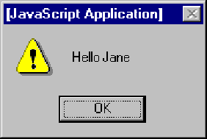

Using Form Data
Personalising an alert box
<form name="alertform">
Enter your name:
<input type="text" name="yourname">
<input type="button" value= "Go" onClick="window.alert('Hello ' + → document.alertform.yourname.value);">
</form>
Notes:
This simple code creates a form called alertform.
The JavaScript is activated when 'Go' button is pressed (an onClick event - see separate Netskills Training Module for more details on Functions and Events in JavaScript). The current value of the element yourname would be displayed in a an alert box.

Slide 48
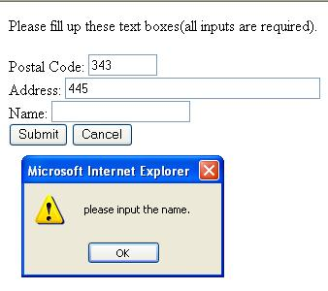
Example Script for Form Validation
<html><head>
<title>Form Validation Checking</title>
<script language="javascript">
<!--
//Calculate to check form input
function checkForm() {
if (document.fm.yubin.value==""){
alert("please input the postal code.");
return false;
}
if (document.fm.address.value==""){
alert("please input the address.");
return false;
}
if (document.fm.name.value==""){
alert("please input the name.");
return false;
}
return true;
}

Slide 49
Example Script for Form Validation…
:
:
//-->
</script> </head><body>
Please fill up these text boxes(all inputs are required).<br>
<form action ="flm.cgi" name="fm" onSubmit="return checkForm()">
Postal Code:
<input type="text" Name="yubin" size="8"><br>
Address:
<input type="text" Name="address" size="40"><br>
Name:
<input type="text" Name="name" size="20"><br>
<input type="submit" value="Submit">
<input type="reset" value="Cancel">
</form></body></html>

Slide 50
External Javascript File
<script language="JavaScript“ src="new_menu7.js"></script

Slide 51
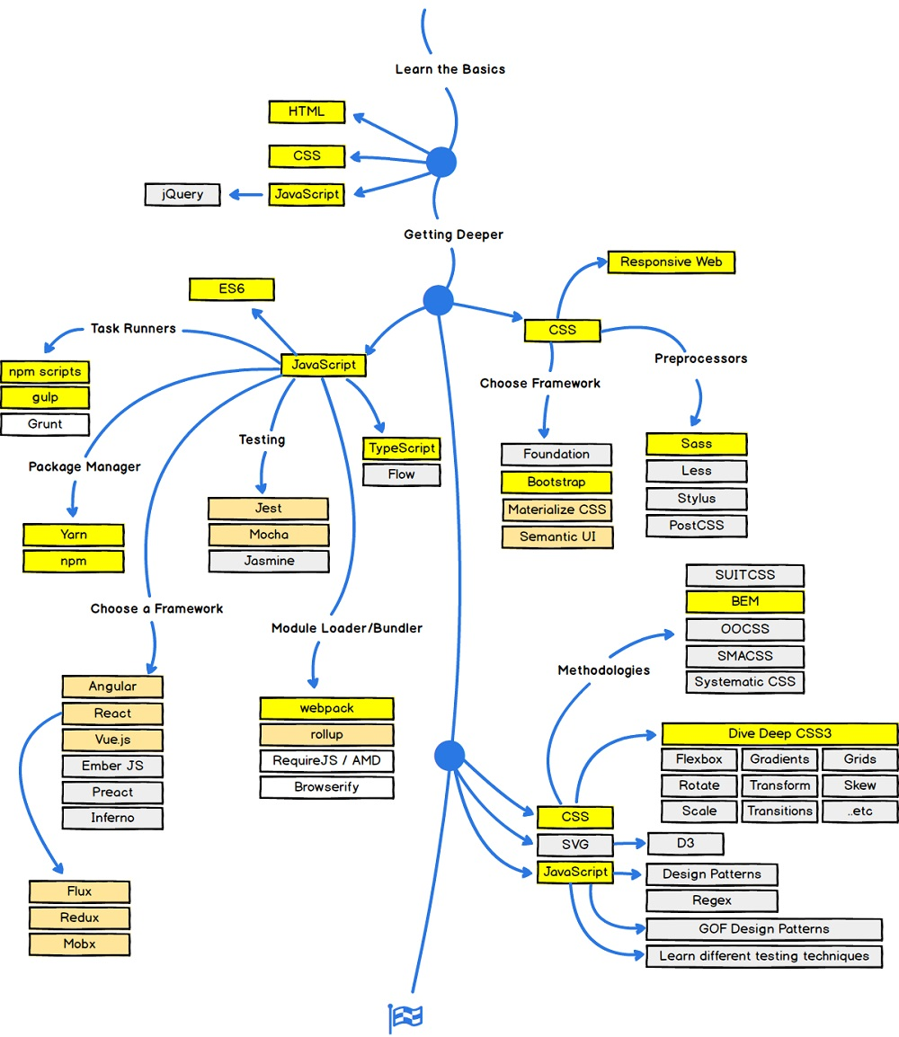

Slide 52
Choose Frameworks
Choose Frameworks
Now it is time to look at some Frameworks.
On the CSS side you should choose a framework for repsonsive web design:
Bootstrap / Material Design / W3.CSS
On the JavaScript side you should learn at least one modern framework:
React.js / Angular.js / Vue.js / W3.JS
Maybe the popularity of jQuery has passed the top, but it is still the most used JavaScript framework.

Slide 53
Summary
  JavaScript is a powerful language and makes a web page dynamic
  JavaScript and Java are fundamentally different in most ways
  JavaScript code is embedded in XHTML code
  JavaScript code is written and tested like XHTML code
  JavaScript begins with variables
  JavaScript uses statements to build code block
  JavaScript has a rich set of operators
  JavaScript has control structures to control code execution
  Code execution follows top to bottom, left to right rule
  Input and output is handled using basic functions

Slide 54
Reference
https://www.tutorialspoint.com/javascript/
https://www.w3schools.com/js/
https://developer.mozilla.org/en-US/docs/Learn/JavaScript/Objects/Object-oriented_JS
http://dynamicdrive.com/

